Slide 1

Fifth International Conference on Sustainable Communication Networks and Application ICSCNA 2024
Organized By
ICSCNA-0281 - AI-Driven Symptom Checker: Leveraging Big Data Technologies for Real-Time
Healthcare Triage and Diagnostics
Authors: Augnik Banerjee, Piyush Baibhav, Nitin Kumar, Aniket Singh, Dr. Gouthaman. P
Date of presentation: 12/12/2024
Affiliation: SRM Institute of Science and Technology

Slide 2
Introduction
Remote and underserved regions face significant delays in diagnosis due to limited access to medical professionals, worsening patient outcomes.
The increasing prevalence of chronic illnesses adds to the challenge, overburdening healthcare systems with large patient populations.
Timely medical intervention can reduce costs, enhance patient outcomes, and alleviate strain on healthcare infrastructure.
Artificial intelligence offers solutions by analyzing vast and diverse patient data for early diagnosis and personalized treatment recommendations.
Real-time processing of continuous data from EHRs, wearables, and remote monitoring systems remains a hurdle in deploying AI effectively.
The work is focused on developing a scalable AI-driven system to enable faster diagnoses, optimize triage, and improve healthcare delivery in resource-constrained areas

Slide 3
Objectives
Developing a scalable AI-driven system for real-time symptom analysis and patient triage.
Integrating diverse healthcare datasets, including EHRs and demographic data, for comprehensive analysis.
Employing big data technologies like Hadoop, Hive, and Spark for efficient data storage and processing.
Implementing machine learning models such as Random Forest and XGBoost for accurate symptom prediction.
Providing real-time insights to healthcare professionals through interactive Tableau dashboards.
Enhancing healthcare accessibility and diagnostic speed, especially in remote and underserved areas.

Slide 4
Literature Review
Year & Journal | Authors | Methodology | Benefits & Challenges
2023, J. Ambient Intell & Hum Comput | Kumar, Y., Koul, A., Singla, R. et al. | AI applied to disease diagnosis using EHRs. | Benefits: Enhanced diagnostic accuracy, reduced human errors. Challenges: Requires high-quality EHR data; data privacy concerns.
2018, npj Digital Medicine | Rajkomar, A., Oren, E., Chen, K. et al. | Deep learning for diagnostic accuracy on EHRs. | Benefits: Improved decision-making; scalable for large datasets. Challenges: Computationally expensive; prone to overfitting.
2019, Nature Medicine | Eric J. Topol | AI in scalable healthcare applications. | Benefits: Real-time response capability; automation of repetitive tasks. Challenges: High dependency on infrastructure and reliable data.

Slide 5
Literature Review
Year & Journal | Authors | Methodology | Benefits
2022, Rheumatology International | Gräf, M., Knitza, J., Leipe, J. et al. | Comparison of AI-based symptom checkers and physicians. | Benefits: Validated diagnostic accuracy of AI tools. Challenges: Limited generalizability to diverse patient demographics..
2022, Int. J. Med. Informatics | Ben-Shabat, Niv & Sharvit, Gal et al. | Chatbot-based symptom checkers for clinical vignettes. | Benefits: Automated triage, reduced waiting times. Challenges: Struggles with complex or ambiguous symptoms.
2024, ICICT Proceedings | Sherin Zafar, Md Afshar Alam et al. | AI-powered chatbots for rural healthcare. | Benefits: Improved accessibility in remote regions. Challenges: Limited by internet availability and technical literacy.

Slide 6
Literature Review
Year & Journal | Authors | Methodology | Benefits
2023, BMC Primary | Mahlknecht, Adolf Engl, G. et al. | Patient and physician attitudes toward AI symptom tools. | Benefits: Supported AI adoption in primary care. Challenges: Resistance to trust AI tools for critical cases.
2020, JMIR Human Factors | Stephen Miller, Stephen Gilbert, V. et al. | AI-based symptom analysis in primary care. | Benefits: Increased patient satisfaction with AI integration. Challenges: Limited availability in resource-constrained clinics.
2021, CHI Conference Proceedings | Chun-Hua Tsai, Yue You, X. et al. | Promoting diagnostic transparency in AI tools. | Benefits: Increased trust through explainability. Challenges: Explainability trade-offs may reduce model efficiency.

Slide 7
Proposed Methodology
Distributed File System: Hadoop ensures scalable and reliable file storage.
Data Storage: PostgreSQL is used for structured storage and efficient querying of healthcare data.
Real-Time Processing: Apache Spark enables fast and distributed data analysis with low latency.
Machine Learning: Implementing Random Forest and XGBoost for accurate symptom analysis.
Visualization: Tableau dashboards provide actionable insights for healthcare professionals.

Slide 8
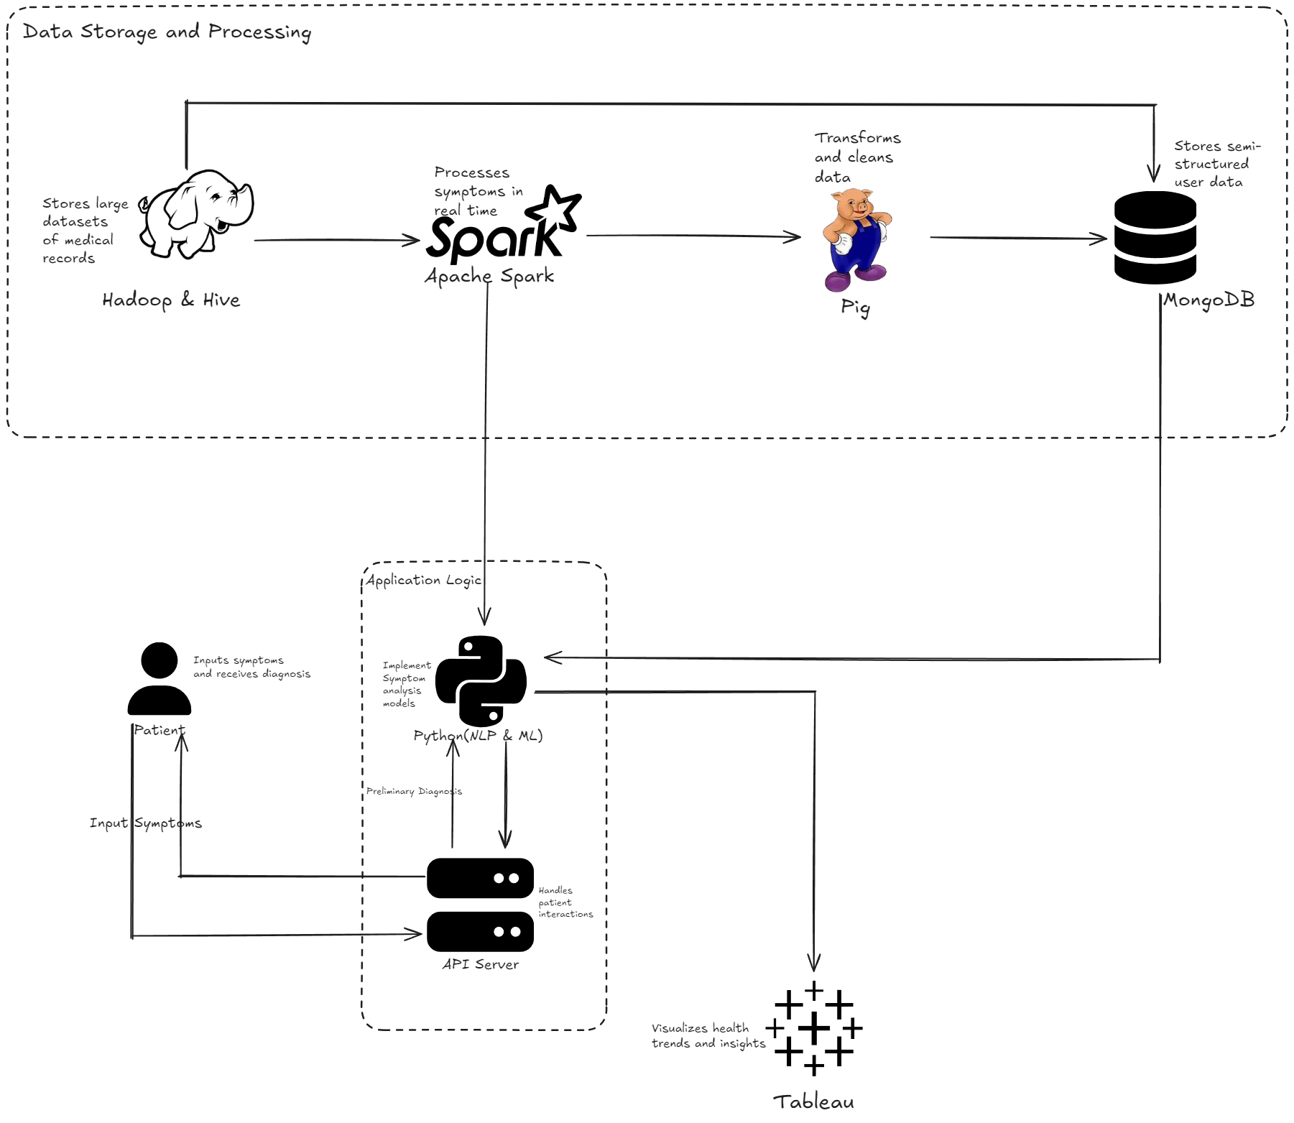
Architecture Diagram

Slide 9
Data Preprocessing
Dataset: Utilizing the MIMIC-III dataset, a large and complex clinical dataset containing detailed patient records.
Data Division: Using Python and PySpark with Hadoop’s HDFS to divide the large dataset into smaller, manageable parts, ensuring efficient processing and accuracy.
Raw Data Cleaning: Handling missing values, removing duplicates, and resolving inconsistencies to prepare high-quality data for analysis.
Dataset Balancing: Applying SMOTE (Synthetic Minority Oversampling Technique) to address class imbalance and improve model predictions.
Data Transformation: Using feature scaling to normalize numerical data and one-hot encoding for categorical variables to make the data machine-readable.
Feature Engineering: Extracting relevant features and discarding redundant information to optimize the dataset for machine learning applications.

Slide 10
Model Selection
Model | Accuracy | Precision | Recall | F1-Score | AUC-ROC | Training Time | Benefits
Logistic Regression | 85.0% | 87.0% | 83.0% | 85.0% | 0.879 | 15 min | Simple, interpretable, good for binary classification.
Random Forest | 97.5% | 96.3% | 94.7% | 97.5% | 0.974 | 25 min | High accuracy, robust to overfitting, handles large datasets well.
XGBoost | 98.1% | 96.9% | 96.3% | 96.9% | 0.945 | 50 min | Fast, handles imbalanced data, superior for large datasets.
Neural Networks | 94.5% | 92.8% | 91.5% | 92.8% | 0.940 | 2+ hours | Learns complex patterns, requires more resources and time.

Slide 11
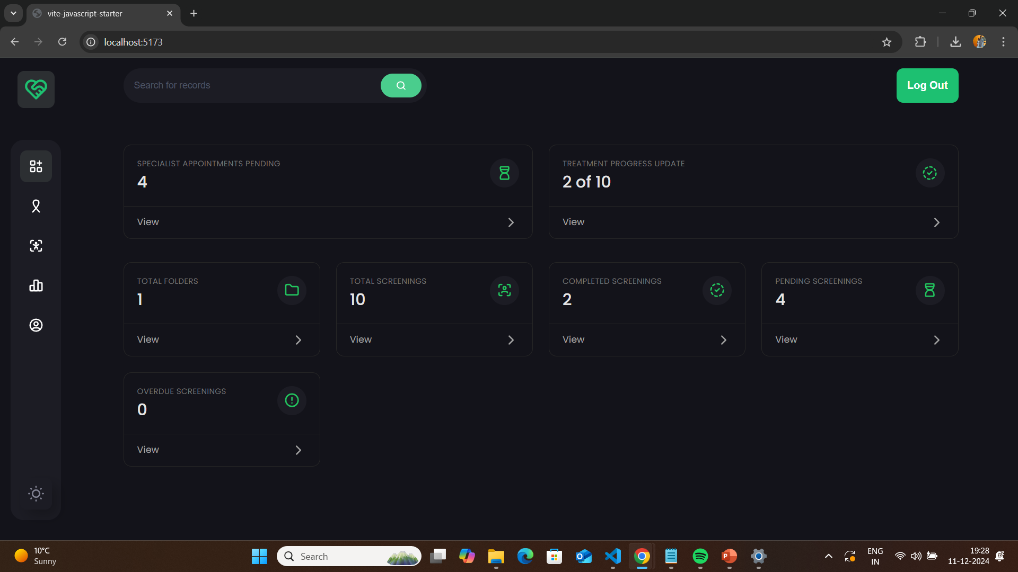
Implementation
Interactive User dashboard

Slide 12
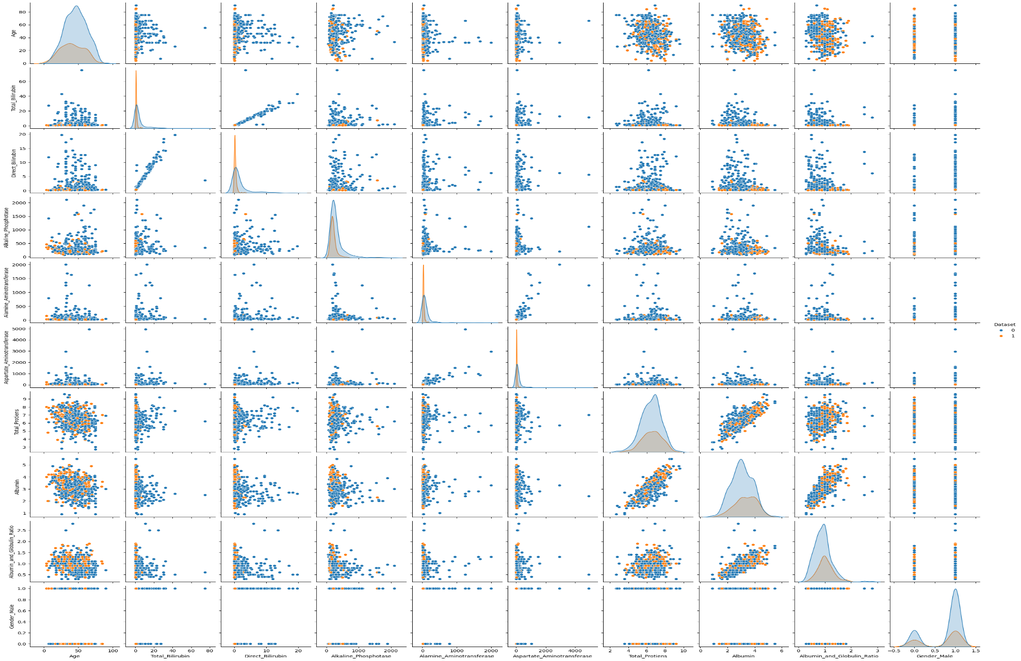
Implementation
Scatter plot using Random Forest Classifier

Slide 13
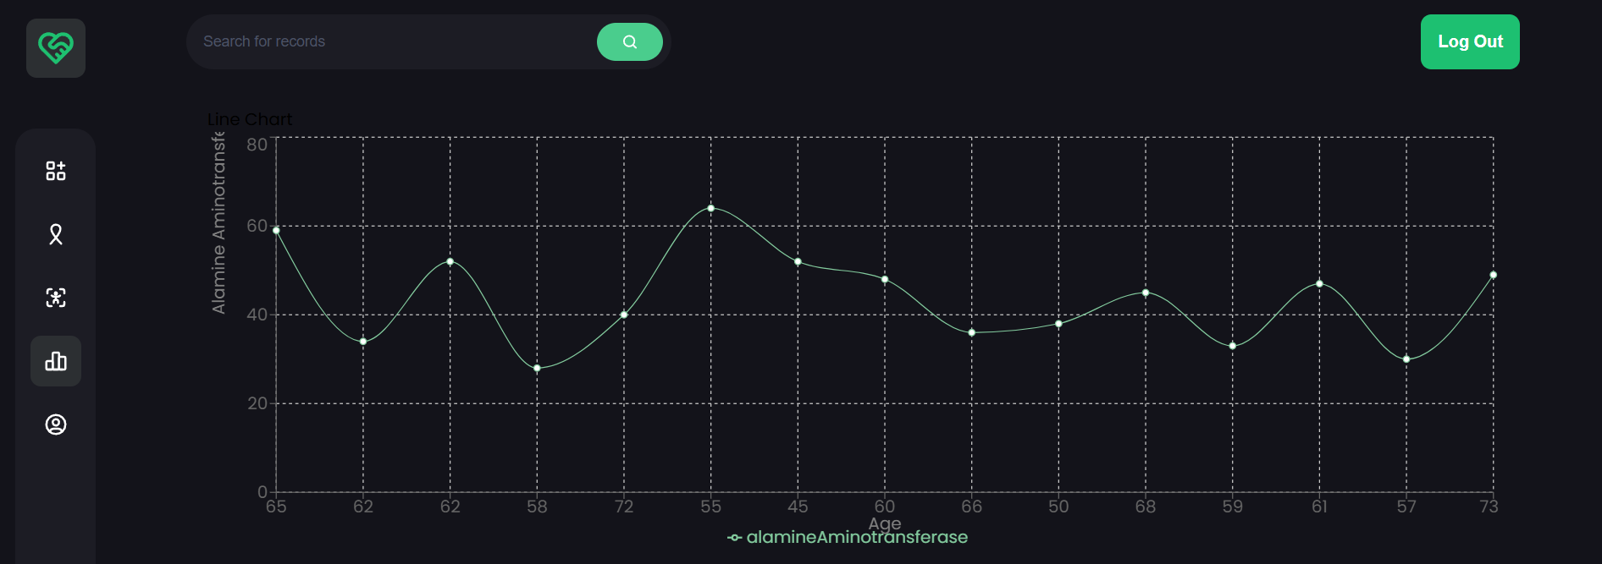
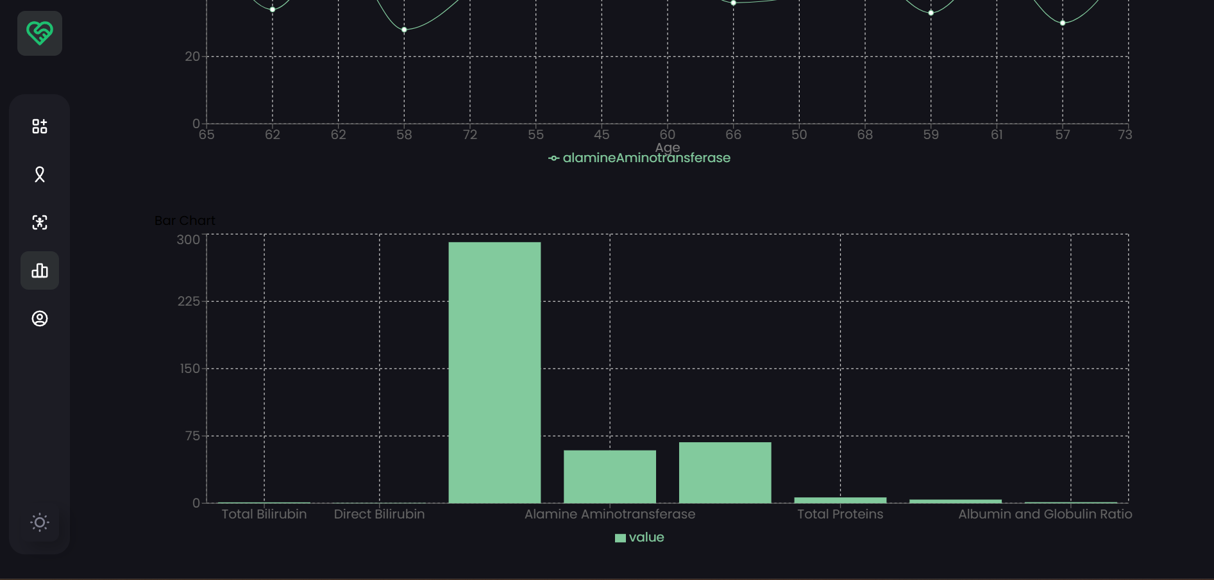
Visualization
Interactive visualization using Bar chart and Line chart with real time processed data

Slide 14
Results
High Accuracy: XGBoost (98.1%) and Random Forest (97.5%) achieved top accuracy, ensuring reliable predictions.
Best Precision & Recall: XGBoost outperformed with 96.9% precision and 96.3% recall, effectively identifying critical symptoms.
Efficient Training: Random Forest and XGBoost were trained in 25-50 minutes, suitable for real-time processing.
Scalable System: PySpark and Hadoop enabled efficient handling of large datasets, ensuring scalability.

Slide 15
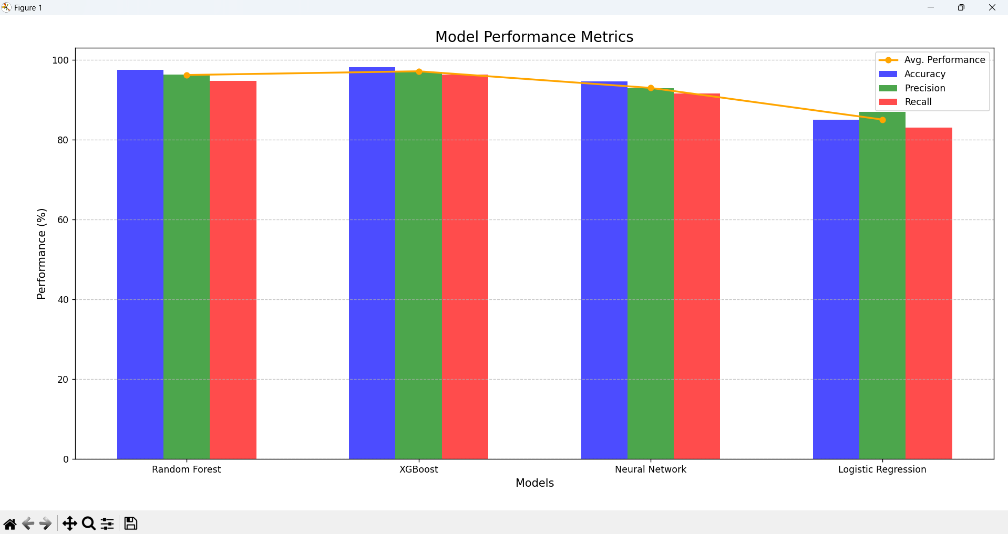
Results

Slide 16
References
A. D, M. M, P. T, T. M, P. S. Sherin A and N. E. R, "Revolutionizing Rural Healthcare in India: AI-Powered Chatbots for Affordable Symptom Analysis and Medical Guidance," 2024 International Conference on Inventive Computation Technologies (ICICT), Lalitpur, Nepal, 2024, pp. 181-187, doi: 10.1109/ICICT60155.2024.10544758
Kumar, Y., Koul, A., Singla, R. et al. Artificial intelligence in disease diagnosis: a systematic literature review, synthesizing framework and future research agenda. J Ambient Intell Human Comput 14, 8459–8486 (2023). https://doi.org/10.1007/s12652-021-03612-z
Rajkomar, A., Oren, E., Chen, K. et al. Scalable and accurate deep learning with electronic health records. npj Digital Med 1, 18 (2018). https://doi.org/10.1038/s41746-018-0029-1
Topol, E.J. High-performance medicine: the convergence of human and artificial intelligence. Nat Med 25, 44–56 (2019). https://doi.org/ 10.1038/s41591-018-0300-7
Mohammad Hammoud, Shahd Douglas, Mohamad Darmach, Sara Alawneh, Swapnendu Sanyal, Youssef Kanbour. ”Avey: An Accurate AI Algorithm for Self-Diagnosis”, doi: https://doi.org/ 10.1101/2022.03.08.22272076
You Y, Ma R, Gui X. User Experience of Symptom Checkers: A Systematic Review. AMIA Annu Symp Proc. 2023 Apr 29;2022:1198-1207. PMID: 37128443; PMCID: PMC10148318.
Gräf, M., Knitza, J., Leipe, J. et al. Comparison of physician and artificial intelligence-based symptom checker diagnostic accuracy. Rheumatol Int 42, 2167–2176 (2022). https://doi.org/10.1007/ s00296-022-05202-4

Slide 17
Thank You!

